Slide 1
Pneumonia Detection with SEResNets
Sumegha Singhania, Nicholas Wen, Erica Shepherd

Slide 2
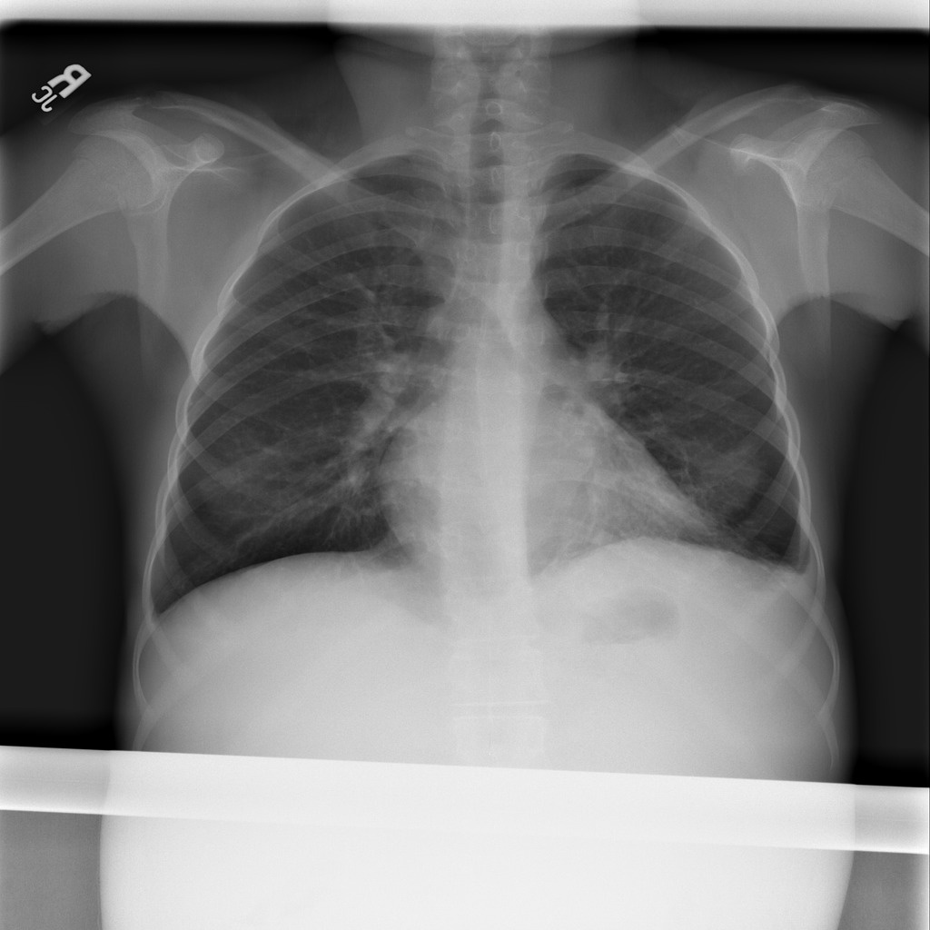
Problem Statement- Pneumonia
Infection of the lungs that cause air sacs to fill with liquid
Over 1 Million affected worldwide
Identification requires
Chest X-ray (CXR)
trained expert
Number of experts creates a bottleneck
Problem Statement: Design a neural network that can identify potential pneumonia cases to reduce the load of trained experts

Slide 3
Background
Honorable Mention: RSNA Pneumonia Detection Challenge- gave the first public dataset of pneumonia images
CheXnet- one of the first examples of using Neural Networks in medical imaging
121 layer dense network that gave probability of various illnesses
Dense networks allows each layer to connect to any previous layer
Sedai et al- Utilizes A-CNN(Attention-CNN) and C-CNN(Classification-CNN) applied to pathology detection
All images have a pathology, but network needs to identify affected area
Affected areas can be subtle or small
A-CNN is used to generate attention map
Squeeze and Excitation (SEBlocks)- Groundbreaking method for attention gaiting
Each channel is reduced to 1 value (squeeze) and and fed through some layers to do attention gaiting
Low additional overhead for network
SENet - Utilizes SEBlocks for pneumonia detection (Main Focus)
Dataset contains both positive and negative examples
Only pneumonia identification is trained

Slide 4
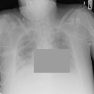
Data
RSNA detection challenge
Training images: 26684 (1024x1024)
Testing images: 3000 (1024x1024)
Data Pre-processing
Erasing pneumonia pixels
Scaling down (128x128)
Data augmentation: scaling, rotation, translation, flipping
Our Datasets:
Smaller dataset: Training images: 3724, Testing images: 300
Larger dataset: Training images: 29469, Testing images: 2631

Slide 5
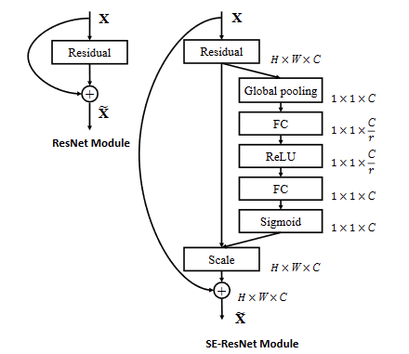
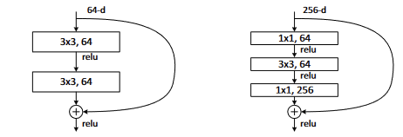
Methods
Inspired by Li et al. paper: “Attention-Guided Convolutional Neural Network for Detecting Pneumonia on Chest X-Rays”
Models: SEResNet-18, SEResNet-34, SEResNet-50, SEResNet-101
Basic Block vs Bottleneck
Loss: cross-entropy
Optimizer: Stochastic Gradient Descent (SGD)
Learning rates: 0.001, 0.0005, 0.0001
Weight decay: 0.0001, 0.00001
Batch sizes: 1, 64
Momentum: 0.9
Accelerates SGD
Predictions: [0, 1]
Accuracy = TP + TN / TP + FP + TN + FN
a. Basic Block b. Bottleneck
Notes:
Images from: https://arxiv.org/pdf/1709.01507.pdf, https://arxiv.org/pdf/1512.03385v1.pdf

Slide 6
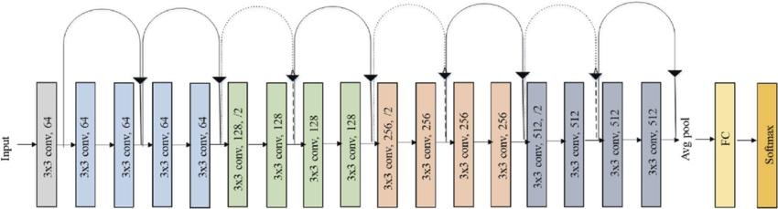
Methods
ResNet-18
Notes:
Image from: https://www.researchgate.net/figure/Original-ResNet-18-Architecture_fig1_336642248

Slide 7
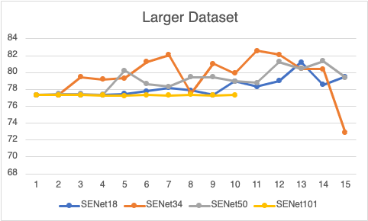
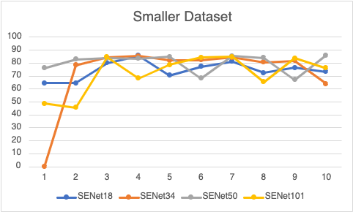
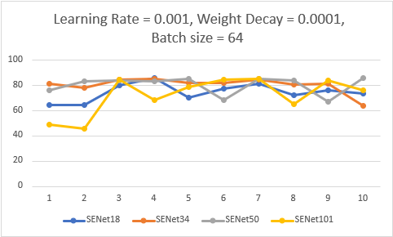
Results

Slide 8
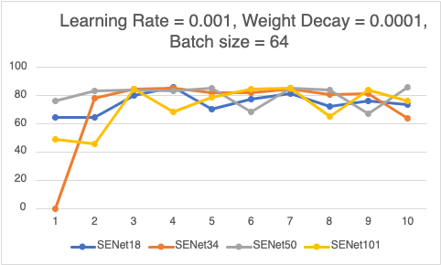
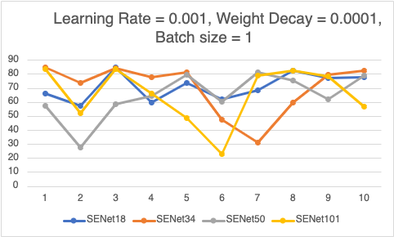
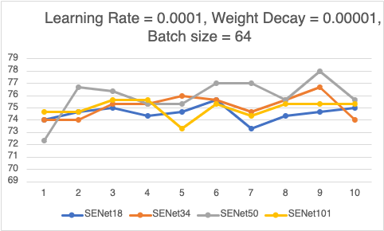
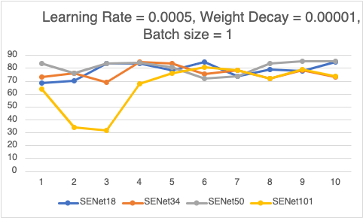
Results

Slide 9
Conclusions and Future Work
Even with SEblocks, networks confirmed traditional neural network wisdom
Lower Learning rate = stable increases, but slower
Higher learning rate = big increases, but unstable
Optimal rates seemed to vary between networks
More noise at a lower batch size
Neural network usage is still not stable enough for wide adoption in medical industry
Future Work
Full scale images
Trained on images that were 128x128 instead of 512x512 or 1024x1024
Expand predictions to include bounding boxes
Train networks for longer to see effect of greater epochs
Fix issues with the erased dataset (missing some pneumonia bounding boxes)
Add lung segmentation to pipeline

Slide 10
References
Rajpurkar, Pranav, et al. "Chexnet: Radiologist-level pneumonia detection on chest x-rays with deep learning." arXiv preprint arXiv:1711.05225 (2017).
Sedai, Suman et al. “Deep multiscale convolutional feature learning for weakly supervised localization of chest pathologies in X-ray images.” MLMI@MICCAI (2018).
Hu, Jie, Li Shen, and Gang Sun. "Squeeze-and-excitation networks." Proceedings of the IEEE Conference on Computer Vision and Pattern Recognition. 2018.
B. Li, G. Kang, K. Cheng and N. Zhang, "Attention-Guided Convolutional Neural Network for Detecting Pneumonia on Chest X-Rays," 2019 41st Annual International Conference of the IEEE Engineering in Medicine and Biology Society (EMBC), 2019, pp. 4851-4854, doi: 10.1109/EMBC.2019.8857277.

